Slide 1
SPORTS IDENTITY OPEN EDUCATIONAL RESources Presentation MODULE 1
Erasmus project “Sport identity” Coordinator:
-Jean Raymond Marquez, CREPS IDF Vice Director
-Bernard Bronchart, Doc of education sciences, youth and sports inspector, manager of the training project, consultant for citizenship CREPS IDF
-Jean-Pierre HALTER, Doc in Sociology
Director:
-Renato MARINO Motor Science Teacher – CSI School for coaches Trainer
-Giuseppe BASSO SUISM Università di Torino Professor – CSI School of coaches Manager

Slide 2
PRESENTATION
Each extremist ideology conveys its own prejudices and stereotypes. Discrimination is an attack on the values of sport (the principle of neutrality, etc.) and contrary to the principle of equal rights.
Violent radicalization is a deviant process of socialization. His analysis is complex. It includes different stages that lead individuals on the path of marginalization and violence (beliefs, communitarianism, radicalization, terrorism). This dynamic draws its sources from the underlying conditions that fuel this dynamic and causes a shift towards reprehensible behaviors. The prevention of violent radicalisation must be as early as possible in this process by mobilizing primary prevention actors.
In the face of radicalisation, the challenge for the world of sport is to preserve the universality of its values in order to enable sports players to promote active citizenship.
The aim of this training module for young youth leaders or sports educators is to enable everyone to know the ethical principles and to appropriate the elements of sport culture that underpin the value of equality (equality refers to a state, in which individuals are treated in the same way and where no discrimination can be tolerated). Freedom and equality are seen as stable benchmarks for the judgment of democracy. The learner is confronted with the diversity of representations of radicalism and evolves his own representations in relation to it.

Slide 3
SUMMARY DESCRIPTION OF THE TRAINING the youth or sport worker (facilitator mediator) is able to identify situations among the young people he supports in which stereotypes, prejudices and discrimination emerge. It identifies the situations, and analyzes the different components to consider avenues of intervention while guaranteeing a socialization framework in line with democratic values.
Learning outcomes | Knowledge | Skills | Implemetation
 | Recognize the weight of prejudices and stereotypes and how these lead to the production of discrimination. Allow learners to understand the social relationships in accordance with the functioning of sport (and democratic societies). Identify the stereotypes and prejudices present in the rhetoric specific to the speeches which relate to the extremist ideologies which are the basis of discrimination. Ethics of sport and values of democratic societies (diversity, tolerance and free choice). | Identify in its practice, the emergence of a fact, of an event contrary to the principles of sport and the questions that this poses for youth and sport stakeholders. Become aware of your own stereotypes. Identify situations in sport where prejudice and stereotypes emerge. Question a situation, alone and in a team, and consider the consequences on the young person, his family, the team, "living together" by deconstructing stereotypes and prejudices Identify manifestations of radicalization leading to marginalization and violence. Identify the facts, attitudes or behaviors that characterize attachment to an extremist ideology. | Discuss the impact of discrimination on the structuring of society and on the behavior of individuals Discuss the impact of one's own beliefs and the beliefs of the different team members on reading stereotypes and prejudices. Share experiences to identify the place of beliefs of all kinds in practice (with young people, in teams) and set up an educational framework to fight against stereotypes, prejudices and discrimination.

Slide 4
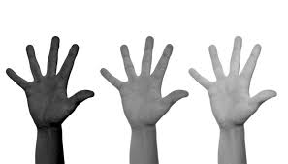
SPORT AND DEMOCRATIC SOCIETY
UNIT 1: BE ABLE TO FIGHT AGAINST DISCRIMINATION
Objectives
1 - Know the different criteria of "discrimination". To date, the law and international conventions to which democratic nations adhere recognize 25 criteria of discrimination.
2 - This module should enable the animators / educators to know the major prejudices and stereotypes which circulate in sport and which can generate discrimination.

Slide 5
SPORT AND DEMOCRATIC SOCIETY
UNIT 1: BE ABLE TO FIGHT AGAINST DISCRIMINATION
The differentiations become “discriminatory” when the selection is made according to illegitimate or illegal criteria.
We could not tolerate that the practice of sport could condone rejection behaviors linked to sexual orientation, morals, religious convictions or even to their origin.
Whether in leisure or high-level practice, these behaviors should not exist. And if not, they must disappear and failing that, be punished. Legally, this unequal treatment is reprehensible if it is based on a criterion prohibited by law.
To feel hatred, fear, incomprehension or to judge a person as inferior, unsuitable or dangerous is not enough to characterize discrimination. For that to happen, there must be an act that brings about a difference in treatment in a similar situation. This is what makes it possible to distinguish discrimination from violence (even if discrimination produces at least symbolic violence) or even racism, sexism or homophobia (which refer to perceptions of the other that do not are not necessarily accompanied by discriminatory acts).

Slide 6
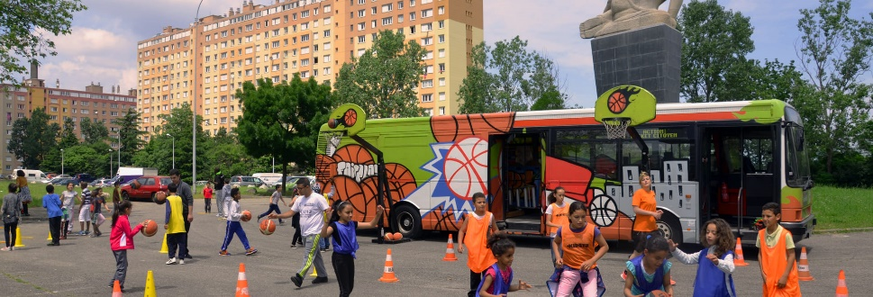
SPORT FOR THE CITIZEN
The development of citizenship, social ties and solidarity is not straightforward:
- civility or mutual and tolerant recognition of individuals among themselves;
- good citizenship, which means respect for the laws and rules in force, and more generally the active behavior of the citizen in daily and public life;
- solidarity, which corresponds to an attitude of openness to others illustrating the republican principle of fraternity and which is reflected on a daily basis by a group of men and women attached to a common project.
It is necessary to remember that citizenship revolves around values, standards, practices and the structuring of social ties. Sport is particularly mobilized on questions of citizenship
Citizenship implies first of all aiming for the common good, the general interest, from the exercise of one's "freedom of participation", exercising one's autonomy of judgment towards others by measuring the potential effects. It is based on equality of dignity and capacity for action of individual citizens. The values ​​are therefore solidarity, freedom, equality and responsibility.

Slide 7
MARSHALL CLASSIFICATION
civil rights (freedom to think, move around, protection of privacy, property ...),
political rights (right to appoint leaders, to be a candidate ...),
social rights (health, education, work, housing ...);
duties of respect for social rules, of participation in social life ... (civility).
A social practice designates an activity carried out by one or more individuals on a recurring basis in accordance or not with standards.
Citizen practices = exercise of rights and duties.
First, exercise of participation in public life in a “conventional” way, within the political framework explicitly dedicated to this purpose (elections) or “unconventional” in broader frameworks allowing the expression of the values and standards of citizenship (associations, collective actions ...).

Slide 8
A SOCIAL STRUCTURING
Citizenship implies a way of understanding the relationship with others ("civic spirit") and feeds a form of social bond between individuals who identify with a community ("community of citizens"), the status of citizen is most often assigned. , the exception being constituted by naturalization.
The stereotype fulfills an important cognitive function: in the face of the abundance of information he receives, the individual simplifies the surrounding reality, categorizes it and classifies it. Categorization is therefore an automatic process. It is the categorization process that governs stereotypes. Categorization is a major process in the construction of Social Identity.
“Stereotypes are shared beliefs about the personal characteristics of a group of people, LEYENS”. What defines the stereotype is its consensual dimension. To measure stereotypes in a concrete way, we will submit to the subject a list of traits concerning a group and the stereotype will be defined from the most massively chosen items (propositions).

Slide 9
SIMPLIFY REALITY BY DEFORMING IT
From stereotypes to prejudices:
Prejudices result from the same process of categorizing and classifying humanity.
They are based on subjective elements, often linked to stereotypical representations, and cross objective data such as physique, age, social status, religion, origin, etc. An individual will therefore be judged on the basis of this opinion applying, by amalgamation, to all the presumed members of his category, this one being able to be constituted on multiple criteria (rich, black, women, Belgians, blond ... ).
Thus, the individual is not evaluated with regard to his personality and his own traits, physical or moral, but on those attributed to all of his congeners.
Action against racism and anti-Semitism often takes the path of combating stereotypes and prejudices. But other forms of prejudice exist, for example the unconditional acceptance and the propagation of certain beliefs set up in indisputable principles, in absolute truths: English is THE international language, we cannot teach a language without its culture, etc. .
These automated or simplified representations, this globalization or generalization of a perceived reality, can certainly allow us to live in society but not to change it.

Slide 10
THE 25 CRITERIA OF DISCRIMINATION
Physical appearance,
age,
health status,
belonging or not to an alleged race,
belonging or not to a nation,
sex,
gender identity,
sexual orientation,
the pregnancy,
disability,
the origin,
religion,
bank domiciliation,
14 political opinions,
15 philosophical opinions,
16 family status,
17 genetic characteristics,
18 manners,
19 the surname,
20 union activities,
21 the place of residence,
22 belonging or not to an ethnic group,
23 loss of autonomy,
24 the ability to express oneself in a foreign language,
25 the vulnerability resulting from its economic situation ...
In sport, there is no room for inequalities and discrimination - voluntary or involuntary, conscious or unconscious, institutional, collective or individual, of any kind.

Slide 11
Elements of discussion on discrimination: gender, origin, ethnicity
The universalism of discourse in sport:
… .Does not adapt to the inferiorization of minorities and women, who are still today victims of representations relating to sport, media coverage (qualitatively or quantitatively) and access to responsibilities (prejudice and discrimination) ….
Negative prejudices die hard in sport. For example, in the imaginary, the black sportsman is often seen as more athletic, endowed with a physical capacity superior to the white sportsman, supposed for his part to develop tactical qualities. The body on one side, the mind on the other.
the black athlete is not smart enough
The white athlete can take on responsibilities that cannot be given to black athletes

Slide 12
EXERCISE
DEFINE A CRITERION AND IDENTIFY A SITUATION OF DISCRIMINATION IN THE FIELD OF SPORT. This step is decisive. We cannot address the issue of radicalization without mentioning the principles that are shared in our democratic societies (and in sport).
IDENTIFY 5 DISCRIMINING STEREOTYPES AND 5 ARGUMENTS TO REFUSE THEM.
DEFINING THE SPECIFIC SKILLS OF WOMEN AND MEN IN SPORT
IDENTIFY THE 25 CRITERIA OF DISCRIMINATION AND GIVE EXAMPLES FROM THE FIELD OF SPORT.

Slide 13
"RADICAL" AND "RADICALITY"
The observation made within the framework of SPORTS IDENTITY first focused on defining the two concepts: terrorism and radicalization. Radicalization, Radicality and Radicalism are particularly connoted today because these terms have undergone a semantic evolution in recent years. Do not confuse radicalism and radicalization.
Common sense defines terrorism as a collection of acts of violence committed by an organization to create a climate of insecurity or to overthrow the established government. Radicalization flirts with the limits of the democratic rule of law. Growing intolerance, which is accompanied by a process of radicalization towards other opinions, is indeed in flagrant contradiction with the foundations of a democratic rule of law, such as freedom of expression and respect for decisions taken democratically. However, this statement should not be used too deterministically, as radicalization is not necessarily against the law nor always results in violent behavior.

Slide 14
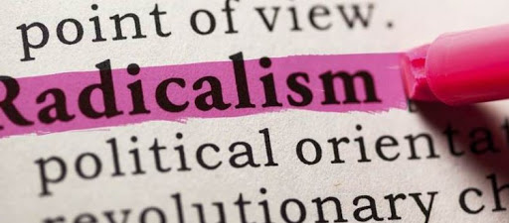
LE RADICALISME
Radicalization means a change, a transformation, a process, an action in progress while Radicality, would be the completed state.
Radicalization is the process of increasing radicalism in a person or group, during which the willingness to fight personally and with the use of violence increases against deep radical changes in society and the democratic legal order and / or to support them, or to encourage others to do so.

Slide 15
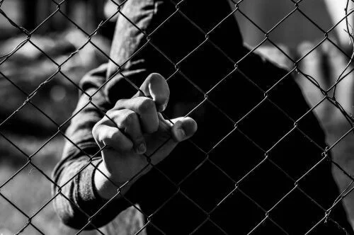
RADICALIZATION
Radicalization is the gradual and evolving adoption of a rigid thought, an absolute and non-negotiable truth, whose logic structures the vision of the world of the actors, who use repertoires of violent action to make it heard, most often within clandestine structures, formalized or virtual, which isolate them from ordinary social referents and send them back a grandiose projection of themselves.
The notion of radicality cannot be limited to political groups with a legal vocation, because “radicality” has to do with the processes of “radicalization”.

Slide 16
EXTRÉMISME
Extremism is the willingness to accept the use of violence, without necessarily resorting to the exercise of violence. In other words, extremism is a mental disposition, which is meant to excuse the use of violence against others, and even implies a predisposition to personally use violence in the future.

Slide 17
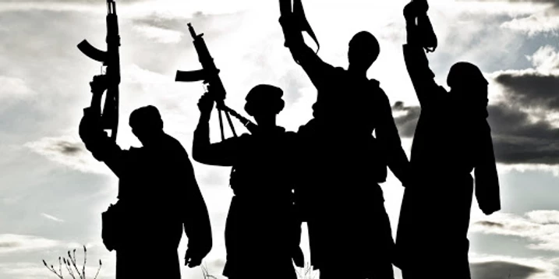
TERRORISM
Terrorism is violent behavior resulting from an ideology that is shared by at least a limited group. Terrorism is distinguished from extremism by the effective use of violence.

Slide 18
THE RADICALIZATION PROCESS
THREE ELEMENTS FOUND
THE EVOLVING DIMENSION THE ADOPTION OF A SECTOR THINKING THE POTENTIAL USE OF ARMED VIOLENCE
The radicalized therefore aim, in general, to change democratic institutions and the egalitarian humanist values ​​on which they are built, or even to a more or less broad social rearrangement to eliminate an "enemy", built ideologically and symbolically as a major figure of 'a world often imagined as Manichean.
Radicalization consists of the development of ideas and activities leading to extreme changes, or even the overthrow of the social or political order, during which the will to resort to violence may increase. Along with this process is the growing acceptance of the extreme personal repercussions of these ideas and activities, ultimately leading to a general behavior of uncompromising and confrontational tendencies with those who stand in the way.
Radicalization is a long process, because severing ties in established society takes time and energy. It is hierarchical in the sense that it can affect groups, generations, groups of co-religionists and individuals. It is also multifaceted because of the different dimensions it encompasses: political, religious or even socio-cultural "(Gielen, 2008).

Slide 19
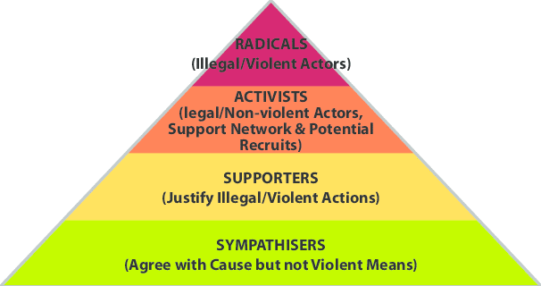
PYRAMIDAL MODEL OF THE RADICALIZATION OF
MC CAULEY AND MOSKALENKO - 2008
- Sympathizers: the individuals who make up its base agree with the cause but do not use violent means (conduct, individual behavior, informal group, so-called virtual or real meeting and exchange)
- Partisans: at the first stage, individuals justify illegal and violent actions (group in the process of formalization, frequency and regularity of meetings and exchanges around a common object, network organization)
- Activists: this stratum is made up of legal and non-violent actors supporting the network and potential recruits (formalized groups, organized and collective behavior and behavior, organization of demonstrations and events with logistics on a common object and objective (passage action for a common cause)
- Violent radicals: at the top of the pyramid are radicals who are illegal and violent actors (strongly structured, hierarchical groups, organized around violent actions)
Pyramid Analysis

Slide 20
L’ESCALIER DE MOGHADDAM
The Moghaddam Staircase has 5 levels.
The "candidate" for radicalization believes he is confronted with injustices on a daily basis and he thinks he can fight or correct them. He then progresses one step. If he feels that he has fewer and fewer non-violent options to advocate against these injustices, he is more likely to continue the process of radicalization. When this is the case, the candidate reaches the second level and shifts his aggression towards the Other. At the third level, the individual morally justifies the use of violence against the one they have identified as the enemy. At the fourth level, he joins an organization with which he associates and indoctrinates. It is at the fifth and final level that its process materializes and the subject swings into violent extremism or terrorist action and which is occupied by sympathizers and the top of the pyramid, by violent radicals.
Example level 0: The individual perceives that he is treated fairly by society.
Level 1 example: The individual experiences a job loss and makes it a personal cause. He sees injustice towards him that he cannot resolve with legal solutions / steps.
Level 2 example: The person who still does not have a job identifies with certain extreme right-wing speeches. So she blames / criticizes immigrants for her problem. There is no physical aggression at this stage.
Level 3 example: Being still unemployed, the individual justifies himself morally. The use of violence is the option.
Level 4 example: The unemployed individual joins an extreme right-wing group that conveys an anti-immigration ideology (discourse of "Us" against "Them").
Example level 5: The unemployed person commits violent criminal acts against public or private institutions or targeted individuals.

Slide 21
COMPARISON AND ANALYSIS OF MODELS
The approach proposed by DIEGO MURO does not mention the stage of entry into radicalization unlike the other models. The author considers that individuals living in representative democracies have the right to carry ideas that attack the roots of problems (the literal meaning of "radical") participate in societal changes. It is the adhesion to an extremist ideology that constitutes the entry into radicalization. It is also used by security and justice actors to prosecute the perpetrators of the attack and their accomplices and helps mobilize prevention actors specialized in secondary and tertiary prevention).
The interest of the modeling proposed by MOGHADDAM lies in the formalization of an initial phase (the entry into radicalization for Moghaddam). This identifies a fertile ground in individuals whose psychological state may constitute underlying conditions that fuel the entry into radicalization (perception of injustice and grievances). This psychological state would allow the passage to other stages: a continuum between radicalism (the individual perceives injustice) and radicalization. Radicalization (which leads to violence) has an evolution that follows a process.
Invia commenti
Cronologia

Slide 22
CATEGORIZE IN SPORT, EVENTS LEADING TO MARGINALIZATION AND VIOLENT RADICALIZATION
1 - Know the rhetorics specific to speeches that are based on extremist ideologies and which are based on the rejection of the values of democratic societies (diversity, tolerance and free choice) by basing its legitimacy on targeted discrimination.
2- Know how to identify the main forms of radicalization in sport and prioritize it.
Invia commenti
Cronologia
Salvate

Slide 23
CATEGORIZE IN SPORT, EVENTS LEADING TO MARGINALIZATION AND VIOLENT RADICALIZATION
Radicalization and violence: extreme thought has always existed, through sects, terrorist organizations, or extreme political movements, in particular. Historically our societies have been marked by violent action of extremist origin which is based on complex mechanisms of the human mind which govern them and which are perfectly identified.
At the macro level: "the root causes" which would promote the eruption of violence: the ordering and changes of the international system, material deprivation or economic grievances, the processes of modernization or their interruption, political culture (in particular the social legitimacy of violence).
At the meso level: "violent" organizations arise from relational dynamics deployed at the level of political systems, opposition movements or even at the intersection between activists, repressive apparatus and counter-movements.
At the micro level: individuals socialized in flexible networks of activism or in the entourage of armed groups (past experiences, primary socializations, formal and informal networks of daily interaction) and decide to join armed groups if they see a a means of defending their points of view, of claiming a life of dignity and of rejecting “subordinate” identities, either out of pride or in reaction to the attacks or failures they have suffered. The violent radical engagement is characterized by the youthfulness of its participants. It appears as an individual response to a questioning of identity specific to certain adolescents or young adults who try to construct meaning by reference to a cause.

Slide 24
THE FOUR FORMS OF RADICALIZATION IN EUROPE AND THE WORLD
Right-wing extremism: promotes spreads nationalism and racism. He discredits other nations, cultures and ethnic groups (debased). It is the questioning of human rights. Hence, right-wing extremists often use historical revisionism rejecting state migration and asylum policy. They are usually organized in small local groups; at the same time, they are part of international identity movements.
• Politico-religious extremism: This is the form of radicalization associated with a political reading of religion and the defense, through violent action, of a religious identity perceived as under attack (international conflicts, foreign policy, debates societal, etc.). This violent radicalization can find its roots in all religions; the religious follows a divine order, in which society and the State must subordinate themselves.
• Left-wing extremism: This is a form of radicalization mainly articulated around demands linked to anti-capitalism and the transformation of a political system perceived as a generator of social inequalities - these demands finding their culmination in violence. Left-wing extremism is ultimately linked with Marx / Engels theory and aims to abandon the existing system and replace it with a communist or anarchist system. It is often linked to anti-capitalism and the search for social equality for all.
• Other Forms of Extremism: Single Cause Extremism. It is essentially a single-cause form of radicalization. This category includes: environmental or animal rights extremists, environmentalists, anti-abortionists, certain homophobic or anti-feminist movements, or even ultra-individualist and autonomist extremists (Freeman on the Land or Sovereign Citizens) using violence to defend their own rights. cause.

Slide 25
EXERCISE 1
What are the prejudices that arise from the various extremist ideologies presented? Who are the target populations?

Slide 26
EXERCISE 2
Presentation of the main forms of manifestations of radicalization in sport.
1 - The behaviors and demands adopted by practitioners aiming to bring about a new “sporting order” which are situated between incivility and offense: discrimination towards other targeted practitioners, “ritual” practices contrary to ethics and culture of sport during sporting time and calling into question democratic principles (diversity, tolerance and freedom of choice)
2 - individuals who practice sport as a preparation before the passage to violent action: Jihad or allowing to confront victoriously other clubs of "supporters" or "hooligans" concealing or not their intentions (phenomenon particularly observed in combat sports, MMA, team sports, bodybuilding, sport shooting)
3 - individuals showing violent behavior (verbal / physical) against people who do not share their ideology (violence against athletes who refuse to cover their private parts when showering)
4 - sports educators "agent" of radicalization who through their training practices encourage forms of communitarianism, in defiance of the values ​​of sport and democratic principles
5 - the affirmation of demonstrations of ideological proselytism, particularly in the field of football, the most significant of which are due to clubs of “pseudo-supporters”, the “ultras”, organized in “small groups” around a “ Identity communitarianism ”accompanies the entry into radicalization of“ young people ”in search of strong emotions and assumes violence and right-wing extremism (anti-Semitism, homophobia, racism)
6 - we must report the perpetrators of attacks targeting the sports sphere, its equipment, its audiences, its champions: the massacre of the Munich Olympics on September 5, 1972, the attack at the Stade de France on November 13, 2015, three explosions during the passage of the bus carrying the players of the German club Dortmund Borussia before a Champions League meeting in their city on April 11, 2017 ...

Slide 27
EXERCISE 3
FROM THE ELEMENTS THAT APPEAR IN UNIT 2 OF MODULE 1 (PYRAMID OF THE RADICALIZATION PROCESS)
To compare the observed manifestations of ideological proselytism in sport when these appear to generate discrimination or / and constitute an offense, a misdemeanor or a crime.
Classify the facts according to the level of the corresponding radicalization process.

Slide 28
THE DIFFICULTY OF A LEGAL QUALIFICATION OF FACTS OF RADICALIZATION
The European Court tells us that “in a democratic society where several religions coexist within the same population, it may prove necessary to place limitations on religious freedom which are capable of reconciling the interests of the various groups and ensuring respect for each person's convictions ”. In other words, while attempting to convert others is allowed, it must not be accompanied by physical or psychological coercion. An offense, a misdemeanor, is only constituted if the actions meet one of the qualifications mentioned in the text: assault, threats, abuse of authority, machinations, culpable artifices or corruption. Mere insistence, even sustained, against an individual to convince him to exercise a cult does not constitute the offense.
The definition of the European Court also provides in its article 9 that the convention does not protect: “proselytizing of bad quality, such as an activity offering material or social advantages or the exercise of an excessive pressure with a view to get church memberships ”. It is considered that religious freedom includes "the right to try to convince one's neighbor", it no longer distinguishes between proselytism and true evangelization, but between proselytism of bad quality and proselytism of good quality.

Slide 29
IN CONCLUSION
It is important to distinguish between the abusive nature of proselytizing, proselytizing behavior and the overt character of religious affiliation. Religious proselytism is not just about wearing a religious dress or symbol. Unlike proselytizing religious behavior, which requires its author to take an active word or deed to convince others, the proselytizing religious sign does not imply any intention or maneuver. The sign produces a proselytizing effect by the very fact that it shows religious affiliation, that it is the support for the exteriorization of religious convictions.
Specific behaviors can occur, such as refusing to shake hands with a person of the opposite sex, to be with them in certain collective places, to work can constitute discrimination. If there is no legal rule imposing a determined rite of politeness and if the practices in this matter evolve according to the country, the ages, the social backgrounds, any behavior undermining the equality between women and men and the dignity of persons is unacceptable and may be regarded as discriminatory.
In public service areas (sports facilities and public swimming pools, etc.), requests for non-mixing must be refused on the basis of the principle of equality between women and men and the prohibition of discrimination.
Observatoire de la laïcité
https://www.gouvernement.fr/sites/default/files/contenu/piece-jointe/2016/10/2._libertes_et_interdits_dans_le_cadre_laique_0.pdf

Slide 30
THANKS

